Slide 1
Outline
●
Minimum Spanning Trees
●
What's the cheapest way to connect a graph?
●
Prim's Algorithm
A simple and efficient algorithm for finding minimum spanning trees.
Exchange Arguments
●
●
●
Another approach to proving greedy algorithms work correctly.

Slide 2
Trees

Slide 3
A tree is an undirected, acyclic, connected graph.

Slide 4
An undirected graph is called minimally connected iff it is connected and removing any edge disconnects it.
Theorem: An undirected graph is a tree iff it is minimally connected.

Slide 6
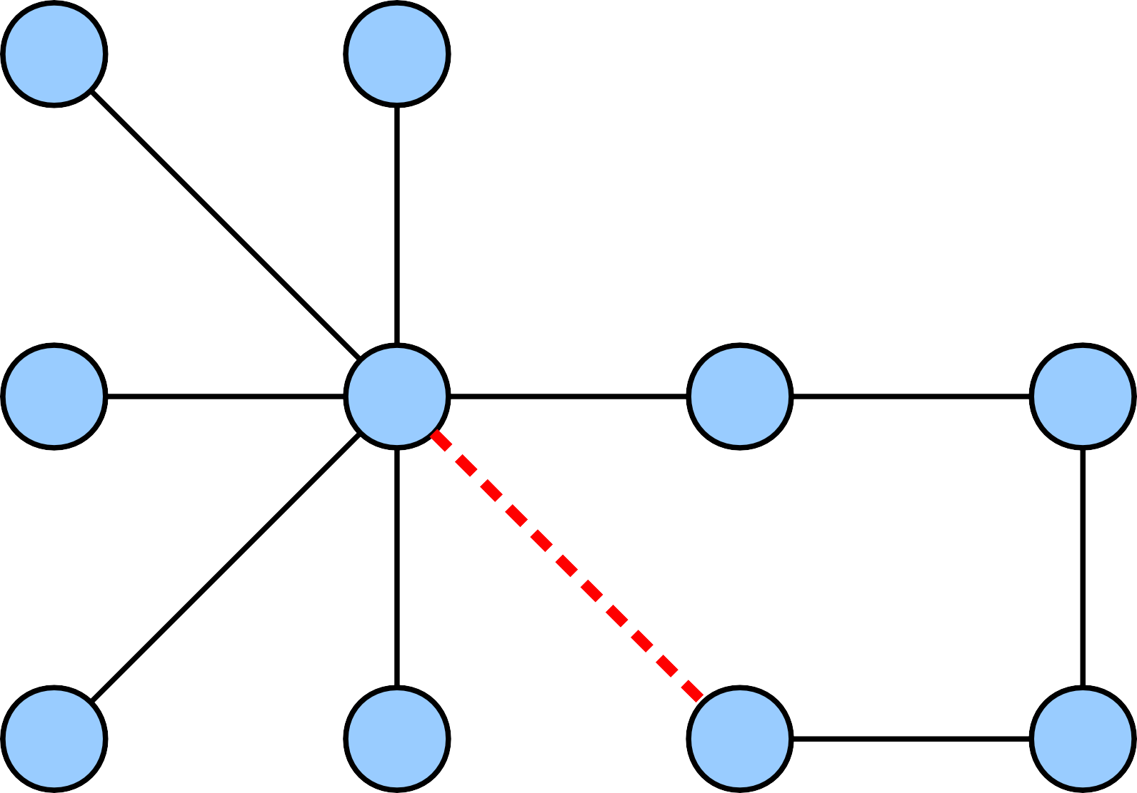

Slide 13
An undirected graph is called maximally acyclic iff adding any missing edge introduces a cycle.
Theorem: An undirected graph is a tree iff it is maximally acyclic.

Slide 14
Theorem: An undirected graph is a tree iff it is connected and |E| = |V| – 1.

Slide 15
Trees
●
A tree is an undirected graph G = (V, E) that is connected and acyclic.
All the following are equivalent:
●
G is a tree.
G is connected and acyclic.
G is minimally connected (removing any edge from G disconnects it.)
G is maximally acyclic (adding any edge creates a cycle)
G is connected and |E| = |V| - 1.
●
●
●
●
●

Slide 16
Theorem: Let T be a tree and (u, v) ∉ T. The graph
T ∪ {(u, v)} contains a cycle. For any edge (x, y) on
the cycle, the graph T' = T ∪ {(u, v)} – {(x, y)} is a tree.
Proof: Since (u, v) ∉ T and (x, y) ∈ T ∪ {(u, v)}, we know
|T'| = |T| + 1 – 1 = |T| = |V| – 1. Therefore, we will show that T' is connected to conclude T' is a tree.
Consider any s, t ∈ V. Since T is connected, there is some path from s to t in T. If that path does not cross (x, y), or if (x, y) = (u, v), then this path is also a path from s to t in T', so s and t are connected in T'. Otherwise, suppose the path from s to t crosses (x, y). Assume without loss of generality that the path starts at s, goes to x, crosses
(x, y), then goes from y to t. Since (u, v) and (x, y) are part of the same cycle, we can modify the original path from s
to t so that instead of crossing (x, y), it goes around the
cycle from x to y. This new path is then a path from s to t in T', so s and t are connected in T'. Thus any arbitrary pair of nodes are connected in T', so T' is connected. ■

Slide 17
Spanning Trees
●
Let G = (V, E). A spanning tree (or ST) of G
is a graph (V, T) such that (V, T) is a tree.
For notational simplicity: we'll identify a spanning tree with just the set of edges T.
Suppose that each edge (u, v) ∈ E is assigned a
cost c(u, v).
The cost of a tree T, denoted c(T), is the sum of the costs of the edges in T:
●
●
●
c (T ) = ∑ c (u, v)
(u, v)∈T
A minimum spanning tree (or MST) of G is a spanning tree T* of G with minimum cost.
●

Slide 18
5
7
1
7
6
6
8
2
3
4
12
1
9

Slide 19
5
7
1
7
6
6
8
2
3
4
12
1
9

Slide 20
5
7
1
7
6
6
8
2
3
4
12
1
9

Slide 21
5
7
1
7
6
6
8
2
3
4
12
1
9

Slide 22
Minimum Spanning Trees

Slide 23
Minimum Spanning Trees
●
There are many greedy algorithms for finding MSTs:
Borůvka's algorithm (1926)
Kruskal's algorithm (1956)
Prim's algorithm (1930, rediscovered 1957)
●
●
●
●
We will explore Kruskal's algorithm and Prim's algorithm in this course.
Lots of research into this problem: parallel implementions, optimal serial implementations, implementations harnessing bitwise operations, etc...
●

Slide 24
7
7
5
5
6
5
6
4
7
1
3
6
4
4
2
3
6
4

Slide 25
7
7
5
5
6
5
6
4
7
1
3
6
4
4
2
3
6
4

Slide 26
7
7
5
5
6
5
6
4
7
1
3
6
4
4
2
3
6
4

Slide 27
7
4
1
10
11
3
12
9
6
5
2
8
7
4
1
10
11
3
12
9
6
5
2
8

Slide 28
7
4
1
10
11
3
12
9
6
5
2
8
7
4
1
10
11
3
12
9
6
5
2
8

Slide 29
4
1
3
12
6
5
2
8
7
4
1
3
9
5
2
8

Slide 30
4
1
3
12
6
5
2
8
7
4
1
3
9
5
2
8

Slide 31
4
1
3
12
6
5
2
8
7
4
1
3
9
6
5
2
8

Slide 32
4
1
3
12
6
5
2
8
7
4
1
3
9
6
5
2
8

Slide 33
4
1
3
12
6
5
2
8
4
1
3
9
6
5
2
8

Slide 34
4
1
3
12
6
5
2
8
4
1
3
9
6
5
2
8

Slide 35
4
1
3
12
9
6
5
2
8
4
1
3
9
6
5
2
8

Slide 36
4
1
3
12
9
6
5
2
8
4
1
3
9
6
5
2
8

Slide 37
4
1
3
9
6
5
2
8
4
1
3
9
6
5
2
8

Slide 38
4
1
3
9
6
5
2
8
4
1
3
9
6
5
2
8

Slide 39
Theorem: Let G be a connected, weighted graph. If all edge weights in G are distinct, G has exactly one MST.
Proof: Since G is connected, it has at least one MST. We will show G has at most one MST by contradiction. Assume T₁ and T₂ are distinct MSTs of G. Since |T₁| = |T₂|, the set
T₁ Δ T₂ is nonempty, so it contains a least-cost edge (u, v).
Assume without loss of generality that (u, v) ∈ T₁.
Consider T₂ ∪ {(u, v)}. Since T₂ is a tree, this graph has a cycle C involving (u, v). Let (x, y) be the edge in C with the highest total cost. We claim c(x, y) > c(u, v). To see this, note that every edge in C other than (u, v) belongs either to T₂ ∩ T₁ or to T₂ – T₁. Some edge in the cycle must belong to T₂ – T₁, or otherwise (u, v) closes a cycle in T₁. The most expensive edge in T₂ – T₁ costs more than c(u, v); otherwise (u, v) would not be the cheapest edge in T₁ Δ T₂. Thus the highest-cost edge in the cycle has cost at least c(u, v).
As proven earlier, T' = T₂ ∪ {(u, v)} – {(x, y)} is a spanning tree of G. But c(T') = c(T₂) + c(u, v) – c(x, y) < c(T₂), which contradicts that T₂ is an MST. Thus our assumption was wrong and there is at most one MST in G. ■

Slide 40
The Cycle Property
●
This previous proof relies on a property of MSTs called the cycle property.
Theorem (Cycle Property): If (x, y) is an edge in G and is the heaviest edge on some cycle C, then (x, y) does not belong to any MST of G.
●
Proof along the lines of what we just saw: if it did belong to some MST, adding the cheapest edge on that cycle and removing (x, y) leaves a lower-cost spanning tree.

Slide 41
Finding MSTs: Prim's Algorithm

Slide 42
7
4
1
10
11
3
12
9
6
5
2
8

Slide 43
7
4
1
10
11
3
12
9
6
5
2
8

Slide 44
7
4
1
10
11
3
12
9
6
5
2
8

Slide 45
7
4
1
10
11
3
12
9
6
5
2
8

Slide 46
7
4
1
10
11
3
12
9
6
5
2
8

Slide 47
7
4
1
10
11
3
12
9
6
5
2
8

Slide 48
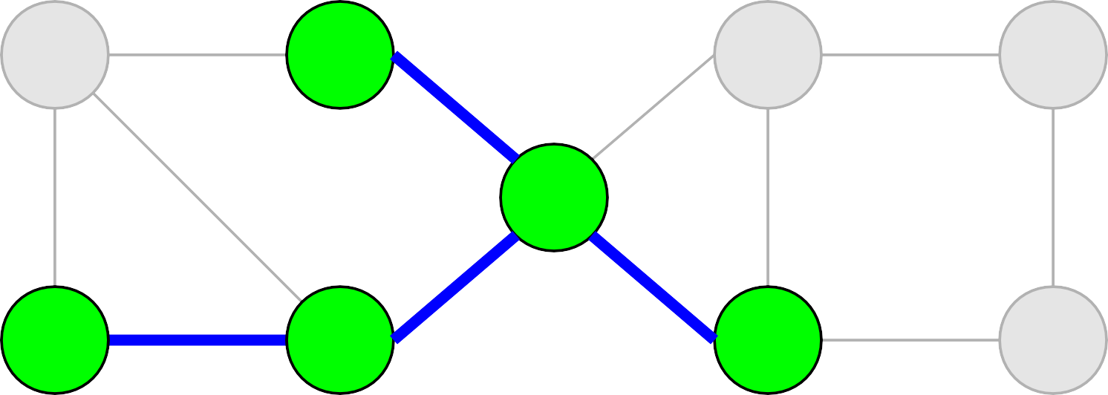
7
4
1
10
11
3
12
9
6
5
2
8

Slide 49
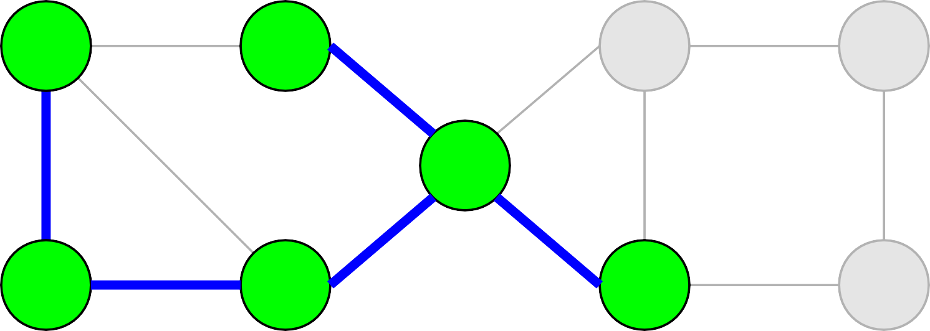
7
4
1
10
11
3
12
9
6
5
2
8

Slide 50
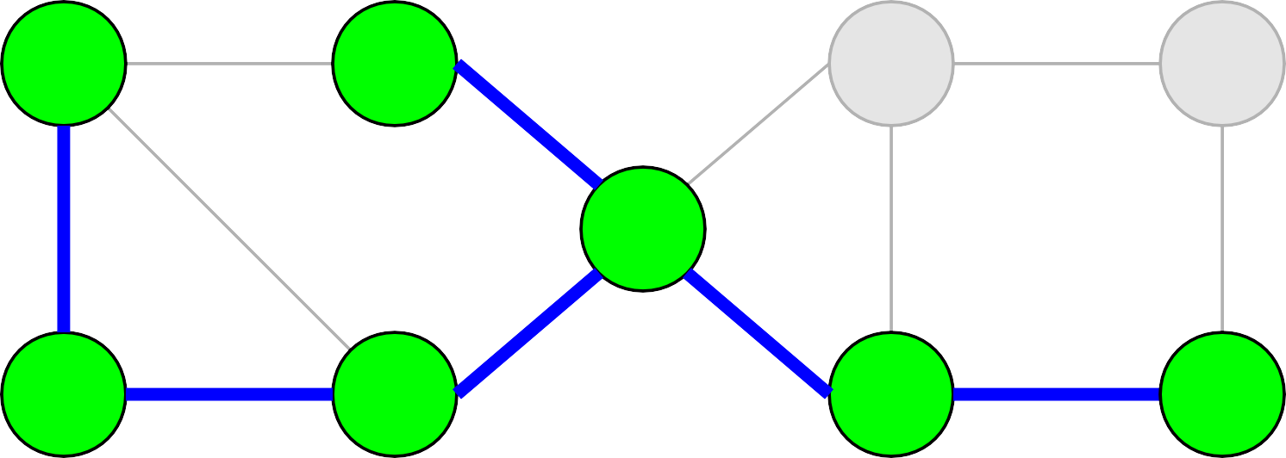
7
4
1
10
11
3
12
9
6
5
2
8

Slide 51
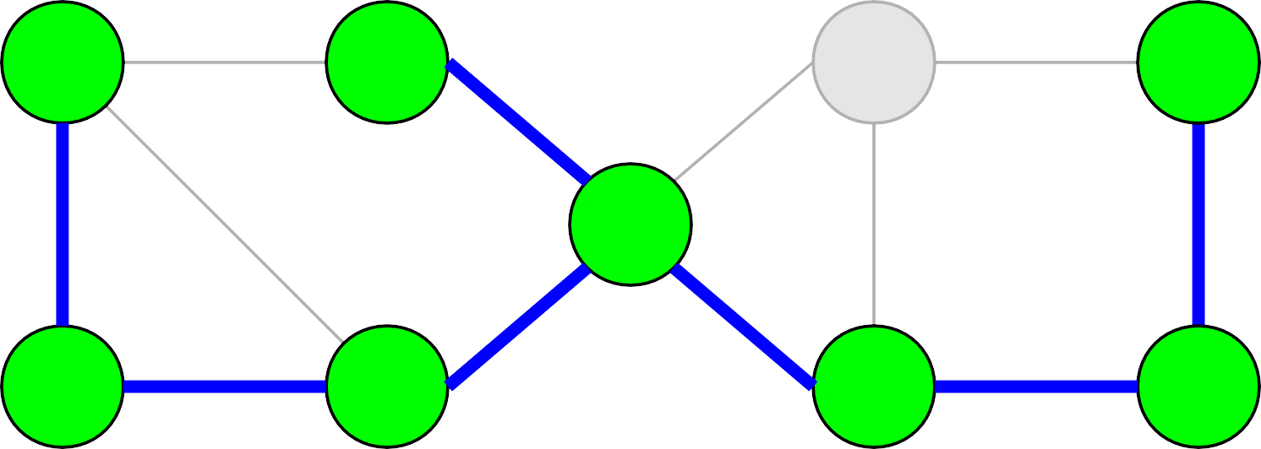
7
4
1
10
11
3
12
9
6
5
2
8

Slide 52
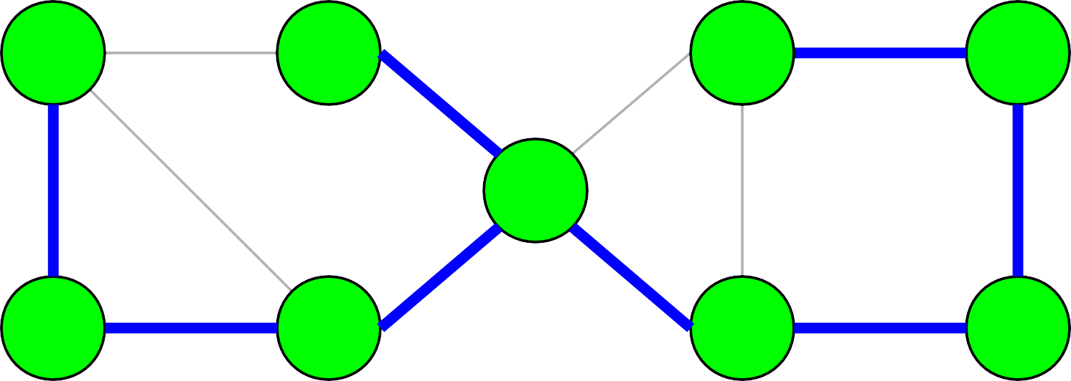
7
4
1
10
11
3
12
9
6
5
2
8

Slide 53
4
1
3
9
6
5
2
8

Slide 54
Prim's Algorithm
●
Prim's Algorithm is the following:
Choose some v ∈ V and let S = {v}. Let T = Ø.
While S ≠ V:
Choose a least-cost edge e with one endpoint in S and one endpoint in V – S.
Add e to T.
Add both endpoints of e to S.
●
●
●
●
(Quick history: This was originally invented by Czech mathematician Vojtěch Jarník in 1930.)

Slide 55
Proving Legality
●
Claim: Prim's algorithm produces a spanning tree of G.
Proof idea: Show by induction that T forms a spanning tree of the nodes in S. Conclude that since eventually S = V, that T is a spanning tree for G.
●

Slide 56
Proving Legality

Slide 57
Proving Optimality
●
To show that Prim's algorithm produces an MST, we will work in two steps:
●
First, as a warmup, show that Prim's algorithm produces an MST as long as all edge costs are distinct.
Then, for the full proof, show that Prim's algorithm produces an MST even if there are multiple edges with the same cost.
●
●
In doing so, we will see the exchange argument as another method for proving a greedy algorithm is optimal.

Slide 58
7
4
1
10
11
3
12
9
6
5
2
8

Slide 59
7
4
1
10
11
3
12
9
6
5
2
8
7
4
1
10
11
3
12
9
6
5
2
8

Slide 60
7
4
1
10
11
3
12
9
6
5
2
8
7
4
1
10
11
3
12
9
6
5
2
8

Slide 61
7
4
1
10
11
3
12
9
6
5
2
8
7
4
1
10
11
3
12
9
6
5
2
8

Slide 62
7
4
1
10
11
3
12
9
6
5
2
8
7
4
1
10
11
3
12
9
6
5
2
8

Slide 63
7
4
1
10
11
3
12
9
6
5
2
8
7
4
1
10
11
3
12
9
6
5
2
8

Slide 64
7
4
1
10
11
3
12
9
6
5
2
8
7
4
1
10
11
3
12
9
6
5
2
8

Slide 65
7
4
1
10
11
3
12
9
6
5
2
8
7
4
1
10
11
3
12
9
6
5
2
8

Slide 66
7
4
1
10
11
3
12
9
6
5
2
8
7
4
1
10
11
3
12
9
6
5
2
8

Slide 67

7
4
1
10
11
3
12
9
6
5
2
8
7
4
1
10
11
3
12
9
6
5
2
8

Slide 68
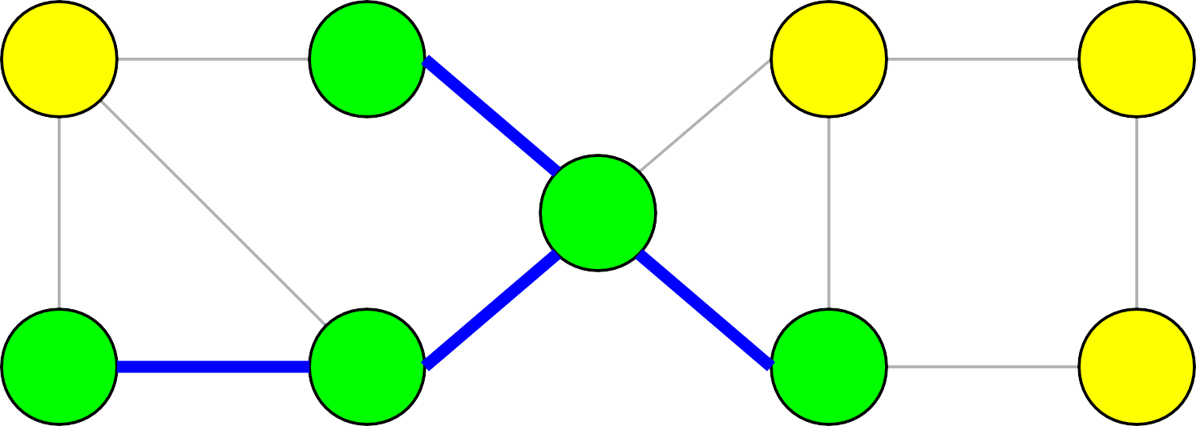
7
4
1
10
11
3
12
9
6
5
2
8
7
4
1
10
11
3
12
9
6
5
2
8

Slide 69
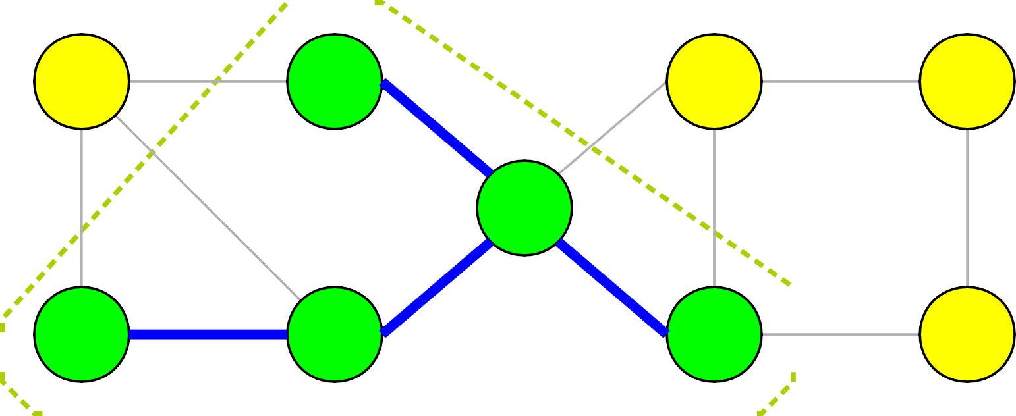
7
4
1
10
11
3
12
9
6
5
2
8
7
4
1
10
11
3
12
9
6
5
2
8

Slide 70

7
4
1
10
11
3
12
9
6
5
2
8
7
4
1
10
11
3
12
9
6
5
2
8

Slide 71
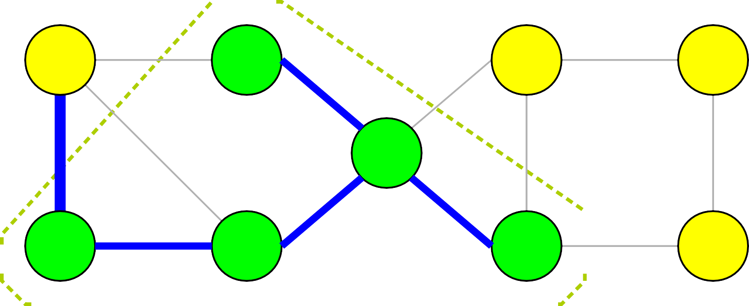
7
4
1
10
11
3
12
9
6
5
2
8
7
4
1
10
11
3
12
9
6
5
2
8

Slide 72
7
4
1
10
11
3
12
9
6
5
2
8
7
4
1
10
11
3
12
9
6
5
2
8

Slide 73
7
4
1
10
11
3
12
9
6
5
2
8
7
4
1
10
11
3
12
9
6
5
2
8

Slide 74
7
4
1
10
11
3
12
9
6
5
2
8
4
1
10
11
3
12
9
6
5
2
8

Slide 76
7
4
1
10
11
3
12
9
6
5
2
8
7
4
1
10
11
3
12
9
6
5
2
8

Slide 77
7
4
1
10
11
3
12
9
6
5
2
8
7
4
1
10
11
3
12
9
6
5
2
8

Slide 78
7
4
1
10
11
3
12
9
6
5
2
8
7
4
1
10
11
3
12
9
6
5
2
8

Slide 79
7
4
1
10
11
3
12
9
6
5
2
8
7
4
1
10
11
3
12
9
6
5
2
8

Slide 80
7
4
1
10
11
3
12
9
6
5
2
8
7
4
1
10
11
3
12
9
6
5
2
8

Slide 81
7
4
1
10
11
3
12
9
6
5
2
8
7
4
1
10
11
3
12
9
6
5
2
8

Slide 82
7
4
1
10
11
3
12
9
6
5
2
8
7
4
1
10
11
3
12
9
6
5
2
8

Slide 83
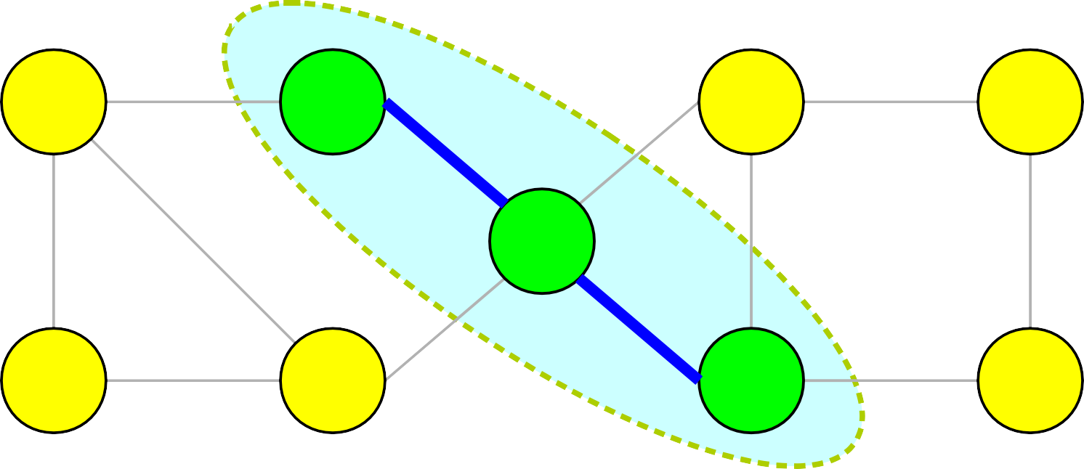
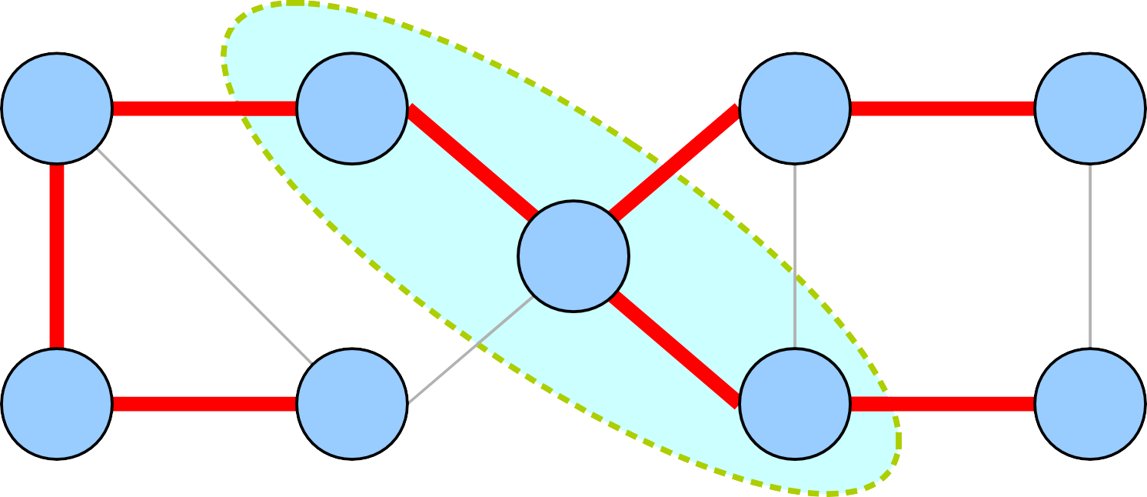
7
4
1
10
11
3
12
9
6
5
2
8
7
4
1
10
11
3
12
9
6
5
2
8

Slide 84
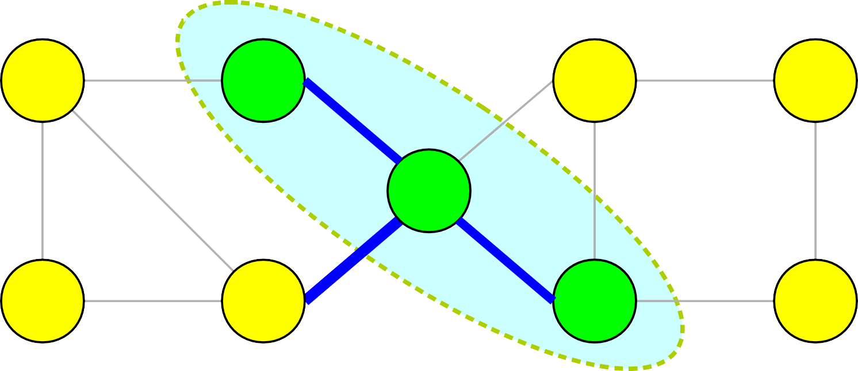
7
4
1
10
11
3
12
9
6
5
2
8
7
4
1
10
11
3
12
9
6
5
2
8

Slide 85
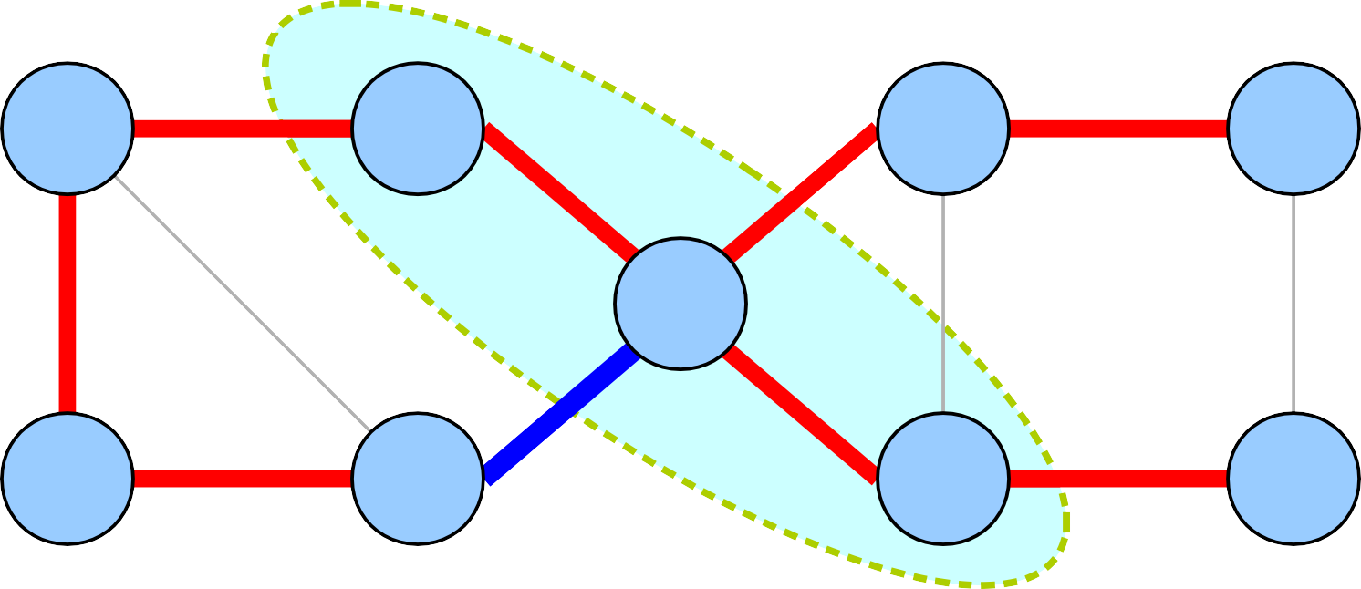
7
4
1
10
11
3
12
9
6
5
2
8
7
4
1
10
11
3
12
9
6
5
2
8

Slide 86
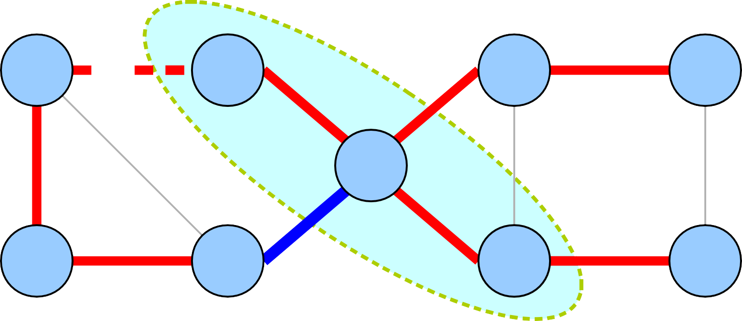
7
4
1
10
11
3
12
9
6
5
2
8
7
4
1
10
11
3
12
9
6
5
2
8

Slide 87
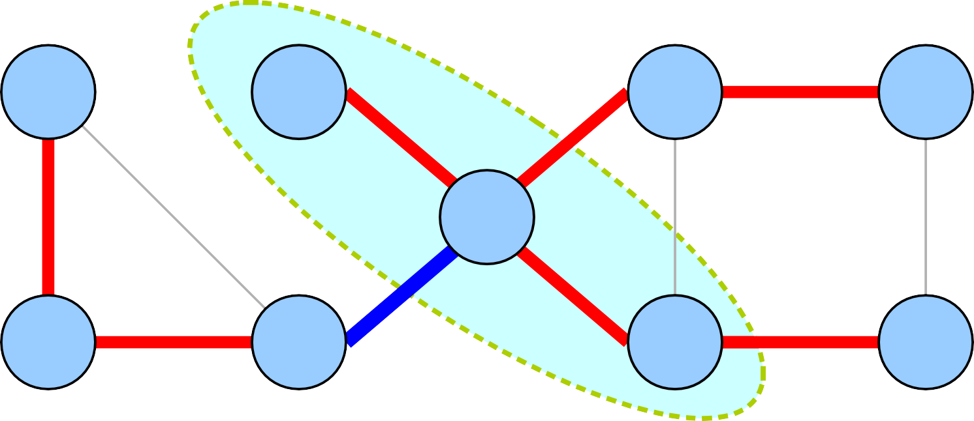
7
4
1
10
11
3
12
9
6
5
2
8
4
1
10
11
3
12
9
6
5
2
8

Slide 88
The Intuition
●
By construction, every edge added in Prim's algorithm is the cheapest edge crossing some cut (S, V – S).
Any tree other than the one produced by Prim's algorithm has to exclude some edge that was included by Prim's algorithm.
Adding that edge closes a cycle that crosses the cut.
Deleting an edge in the cycle that crosses the cut strictly lowers the cost of the tree.
●
●
●

Slide 89
Theorem: If G is a connected, weighted graph with distinct edge weights, Prim's algorithm correctly finds an MST.
Proof: Let T be the spanning tree found by Prim's algorithm and T* be the MST of G. We will prove T = T* by contradiction. Assume T ≠ T*. Therefore, T – T* ≠ Ø. Let (u, v) be any edge in T – T*.
When (u, v) was added to T, it was the least-cost edge crossing some cut (S, V – S). Since T* is an MST, there must be a path from u to v in T*. This path begins in S and ends in V – S, so there must be some edge (x, y) along that path where x ∈ S and y ∈ V – S. Since (u, v) is the least- cost edge crossing (S, V – S), we have c(u, v) < c(x, y).
Let T*' = T* ∪ {(u, v)} – {(x, y)}. Since (x, y) is on the cycle formed by adding (u, v), this means T*' is a spanning tree. However, c(T*') = c(T*) + c(u, v) – c(x, y) < c(T*), contradicting that T* is an MST.
We have reached a contradiction, so our assumption must have been wrong. Thus T = T*, so T is an MST. ■

Slide 90
Exchange Arguments
●
This proof of optimality for Prim's algorithm uses an argument called an exchange argument.
General structure is as follows *
●
●
Assume the greedy algorithm does not produce the optimal solution, so the greedy and optimal solutions are different.
Show how to exchange some part of the optimal solution with some part of the greedy solution in a way that improves the optimal solution.
Reach a contradiction and conclude the greedy and optimal solutions must be the same.
●
●
●
(* This assumes there is a unique optimal solution; we'll generalize this shortly.)

Slide 91
The Cut Property
●
The previous correctness proof relies on a property of MSTs called the cut property:
Theorem (Cut Property): Let (S, V – S)
be a nontrivial cut in G (i.e. S ≠ Ø and S ≠ V).
If (u, v) is the lowest-cost edge crossing (S, V – S), then (u, v) is in every MST of G.
●
Proof uses an exchange argument: swap out the lowest-cost edge crossing the cut for some other edge crossing the cut.

Slide 92
One Problem
●
This proof of correctness relies on edge weights being distinct in two ways:
●
Assumes there is a unique MST in the graph.
Assumes swapping one edge crossing the cut for another strictly improves the cost of an alleged MST.
●
●
Neither of these are true if weights can be duplicated.
How do we account for this?
●

Slide 93
1
2
1
2
3
1
3
1
2
2
1
2
2
1
1
4
1
4
2
3
2
3
2
4
2
4
1
1

Slide 94
1
2
1
2
3
1
3
1
2
2
1
2
2
1
1
4
1
4
2
3
2
3
2
4
2
4
1
1

Slide 95
1
2
1
2
3
1
3
1
2
2
1
2
2
1
1
4
1
4
2
3
2
3
2
4
2
4
1
1

Slide 96
1
2
1
2
3
1
3
1
2
2
1
2
2
1
1
4
1
4
2
3
2
3
2
4
2
4
1
1

Slide 97
1
2
1
2
3
1
3
1
2
2
1
2
2
1
1
4
1
4
2
3
2
3
2
4
2
4
1
1

Slide 98
1
2
1
2
3
1
3
1
2
2
1
2
2
1
1
4
1
4
2
3
2
3
2
4
2
4
1
1

Slide 99
1
2
1
2
3
1
3
1
2
2
1
2
2
1
1
4
1
4
2
3
2
3
2
4
2
4
1
1

Slide 100
1
2
1
2
3
1
3
1
2
2
1
2
2
1
1
4
1
4
2
3
2
3
2
4
2
4
1
1

Slide 101
1
2
1
2
3
1
3
1
2
2
1
2
2
1
1
4
1
4
2
3
2
3
2
4
2
4
1
1

Slide 102
1
2
1
2
3
1
3
1
2
2
1
2
2
1
1
4
1
4
2
3
2
3
2
4
2
4
1
1

Slide 103
1
2
1
2
3
1
3
1
2
2
1
2
2
1
1
4
1
4
2
3
2
3
2
4
2
4
1
1

Slide 104
1
2
1
1
1
1
2
1
1
1
2
2
1
1

Slide 105
1
2
1
2
3
1
3
1
2
2
1
2
2
1
1
4
1
4
2
3
2
3
2
4
2
4
1
1

Slide 106
1
2
1
2
3
1
3
1
2
2
1
2
2
1
1
4
1
4
2
3
2
3
2
4
2
4
1
1

Slide 107
1
2
1
2
3
1
3
1
2
2
1
2
2
1
1
4
1
4
2
3
2
3
2
4
2
4
1
1

Slide 108
1
2
1
2
3
1
3
1
2
2
1
2
2
1
1
4
1
4
2
3
2
3
2
4
2
4
1
1

Slide 109
1
2
1
2
3
1
3
1
2
2
1
2
2
1
1
4
1
4
2
3
2
3
2
4
2
4
1
1

Slide 110
1
2
1
2
3
1
3
1
2
2
1
2
2
1
1
4
1
4
2
3
2
3
2
4
2
4
1
1

Slide 111
1
2
1
2
3
1
3
1
2
2
1
2
2
1
1
4
1
4
2
3
2
3
2
4
2
4
1
1

Slide 112
1
2
1
2
3
1
3
1
2
2
1
2
2
1
1
4
1
4
2
3
2
3
2
4
2
4
1
1

Slide 113

1
2
1
2
3
1
3
1
2
2
1
2
2
1
1
4
1
4
2
3
2
3
2
4
2
4
1
1

Slide 114
1
2
1
2
3
1
3
1
2
2
1
2
2
1
1
4
1
4
2
3
2
3
2
4
2
4
1
1

Slide 115
1
2
1
2
3
1
3
1
2
2
1
2
2
1
1
4
1
4
2
3
2
3
2
4
2
4
1
1

Slide 116
1
2
1
2
3
1
3
1
2
2
1
2
2
1
1
4
1
4
2
3
2
3
2
4
2
4
1
1

Slide 117
1
2
1
2
3
1
3
1
2
2
1
2
2
1
1
4
1
4
2
3
2
3
2
4
2
4
1
1

Slide 118
1
2
1
2
3
1
3
1
2
2
1
2
2
1
1
4
1
4
2
3
2
3
2
4
2
4
1
1

Slide 119
1
2
1
2
3
1
3
1
2
2
1
2
2
1
1
4
1
4
2
3
2
3
2
4
2
4
1
1

Slide 120
1
2
1
2
3
1
3
1
2
2
1
2
2
1
1
4
1
4
2
3
2
3
2
4
2
4
1
1

Slide 121
1
2
1
2
3
1
3
1
2
2
1
2
2
1
1
4
1
4
2
3
2
3
2
4
2
4
1
1

Slide 122
1
2
1
2
3
1
3
1
2
2
1
2
2
1
1
4
1
4
2
3
2
3
2
4
2
4
1
1

Slide 123
1
2
1
2
3
1
3
1
2
2
1
2
2
1
1
4
1
4
2
3
2
3
2
4
2
4
1
1

Slide 124
1
2
1
2
3
1
3
1
2
2
1
2
2
1
1
4
1
4
2
3
2
3
2
4
2
4
1
1

Slide 125
1
2
1
2
3
1
3
1
2
2
1
2
2
1
1
4
1
4
2
3
2
3
2
4
2
4
1
1

Slide 126
1
2
1
2
3
1
3
1
2
2
1
2
2
1
1
4
1
4
2
3
2
3
2
4
2
4
1
1

Slide 127
1
2
1
2
3
1
3
1
2
2
1
2
2
1
1
4
1
4
2
3
2
3
2
4
2
4
1
1

Slide 128
1
2
1
2
3
1
3
1
2
2
1
2
2
1
1
4
1
4
2
3
2
3
2
4
2
4
1
1

Slide 129



1
2
1
2
3
1
3
1
2
2
1
2
2
1
1
4
1
4
2
3
2
3
2
4
2
4
1
1

Slide 130
1
2
1
2
3
1
3
1
2
2
1
2
2
1
1
4
1
4
2
3
2
3
2
4
2
4
1
1

Slide 131
1
2
1
2
3
1
3
1
2
2
1
2
2
1
1
4
1
4
2
3
2
3
2
4
2
4
1
1

Slide 132
1
2
1
2
3
1
3
1
2
2
1
2
2
1
1
4
1
4
2
3
2
3
2
4
2
4
1
1

Slide 133
1
2
1
2
3
1
3
1
2
2
1
2
2
1
1
4
1
4
2
3
2
3
2
4
2
4
1
1

Slide 134
1
2
1
2
3
1
3
1
2
2
1
2
2
1
1
4
1
4
2
3
2
3
2
4
2
4
1
1

Slide 135
1
2
1
2
3
1
3
1
2
2
1
2
2
1
1
4
1
4
2
3
2
3
2
4
2
4
1
1

Slide 136
1
2
1
2
3
1
3
1
2
2
1
2
2
1
1
4
1
4
2
3
2
3
2
4
2
4
1
1

Slide 137
1
2
1
2
3
1
3
1
2
2
1
2
2
1
1
4
1
4
2
3
2
3
2
4
2
4
1
1

Slide 138
1
2
1
2
1
1
1
1
1
1
2
2
1
1

Slide 139
Exchange Arguments
●
A more general version of an exchange argument is as follows.
●
Let X be the object produced by a greedy algorithm and X* be any optimal solution.
If X = X*, the algorithm is optimal.
Otherwise, show that you can exchange some piece of X* for some piece of X without deteriorating the quality of X*.
Argue that this process can be iterated repeatedly to turn X* into X without changing its cost.
Conclude that X is optimal.
●
●
●
●

Slide 140
Theorem: If G is a connected, weighted graph, Prim's algorithm correctly finds an MST in G.
Proof: Let T be the spanning tree found by Prim's algorithm and T* be any MST of G. We will prove c(T) = c(T*). If T = T*, then c(T) = c(T*) and we are done.
Otherwise, T ≠ T*, so we have T – T* ≠ Ø. Let (u, v) be any edge in T – T*. When (u, v) was added to T, it was a least- cost edge crossing some cut (S, V – S). Since T* is an MST, there must be a path from u to v in T*. This path begins in S and ends in V – S, so there must be some edge (x, y) along that path where x ∈ S and y ∈ V – S. Since (u, v) is a
least-cost edge crossing (S, V – S), we have c(u, v) ≤ c(x, y).
Let T*' = T* ∪ {(u, v)} – {(x, y)}. Since (x, y) is on the cycle formed by adding (u, v), this means T*' is a spanning tree.
Notice c(T*') = c(T*) + c(u, v) – c(x, y) ≤ c(T*). Since T* is an MST, this means c(T*') ≥ c(T*), so c(T*) = c(T*').
Note that |T – T*'| = |T – T*| – 1. Therefore, if we repeat this process once for each edge in T – T*, we will have converted T* into T while preserving c(T*). Thus c(T) = c(T*). ■

Slide 141
A Note on the Proof
Find a way to replace one piece of T* with one piece of T without increasing c(T*).
Note that this makes T* “less different” than T as before.
Conclude that we could iterate this process until eventually T* became T, at which point we have c(T) = c(T*).
●
Our proof worked as follows:
●
●
●
●
This is inherently an inductive argument, but typically it is not presented as such.
●
It's fine to say “repeat this process” rather than writing out a base case and inductive step.

